Slide 1
2012 ASME DOB Meeting
Apr. 21, 2012
Status of ASME Taiwan Section
Pei-Chun Lin
National Taiwan University
Mechanical Engineering

Slide 2
Organization Chart
Board of Directors
Section Chair
Professor J. Andrew Yeh
Secretary General
Membership
Committee
Education and
Training
Committee
Industry
Cooperation
Committee
Publication
Committee
Finance
Committee
Notes:
各委員會主委的名單？

Slide 3
Membership Status
103 members
  90 from university
  9 from industry
  4 from government research institute

Slide 4
Officers
Prof. J. Andrew Yeh was elected to be the Section Chair in March, 2012.
Pei-Chun Lin was appointed to be Deputy Secretary General in March 2012 to assist the administration of Taiwan section
Pei-Chun Lin will potentially take Secretary General upon the appointment verification by Ministry of Interior, Taiwan

Slide 5
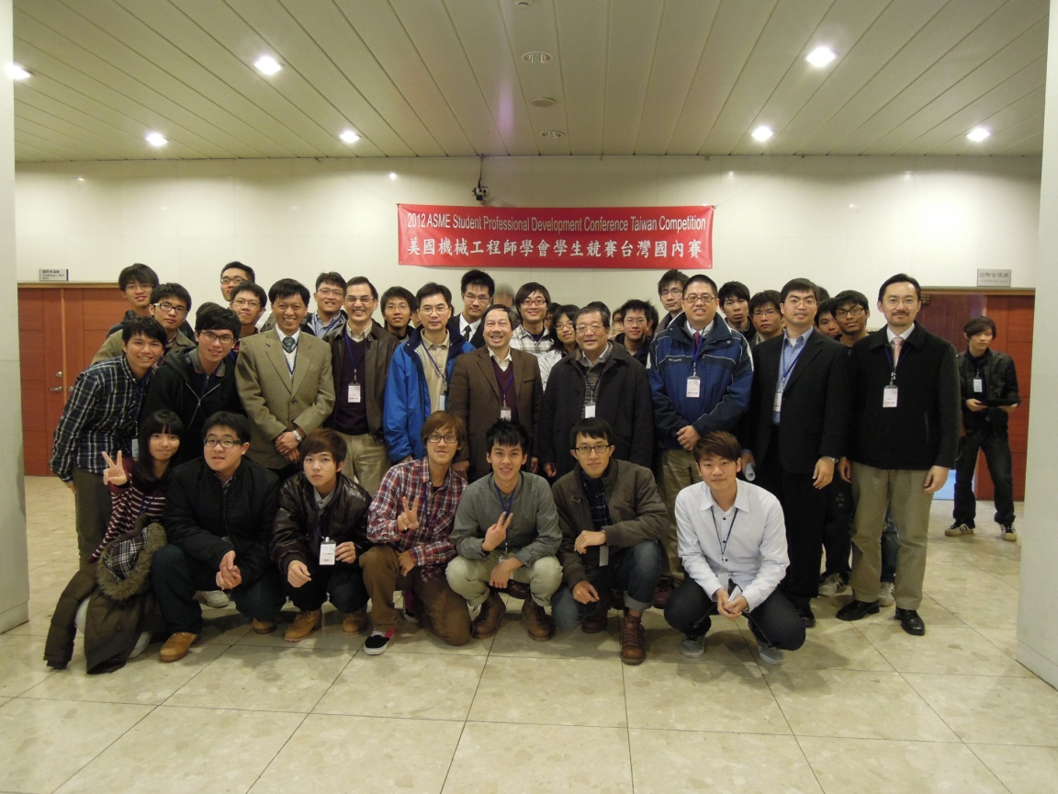
SPDC in Taiwan Section
Held on Mar. 11, 2012
Two competitions
  Student Design Competition – 6 teams
  Old Guard Oral Competition – 7 teams

Slide 6
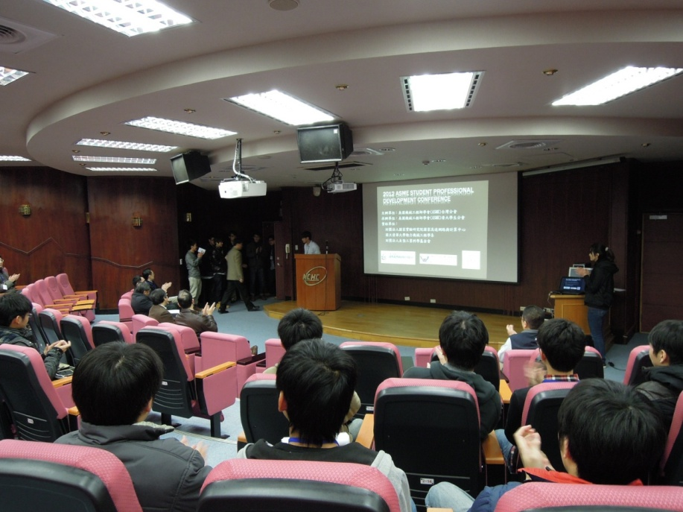
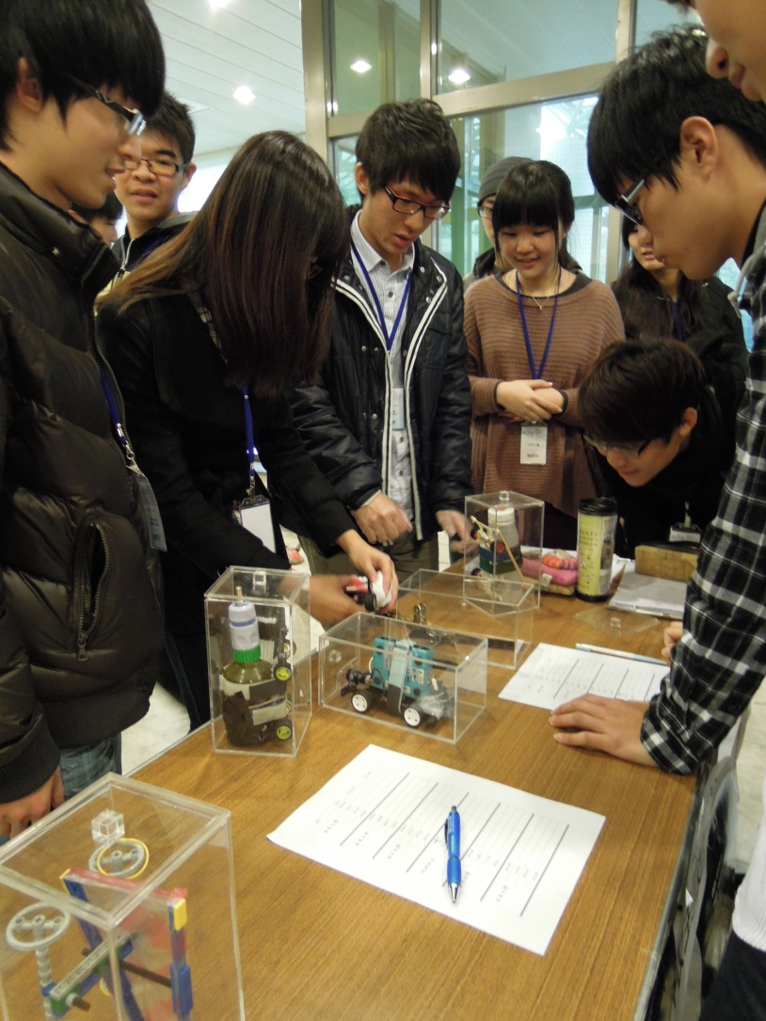
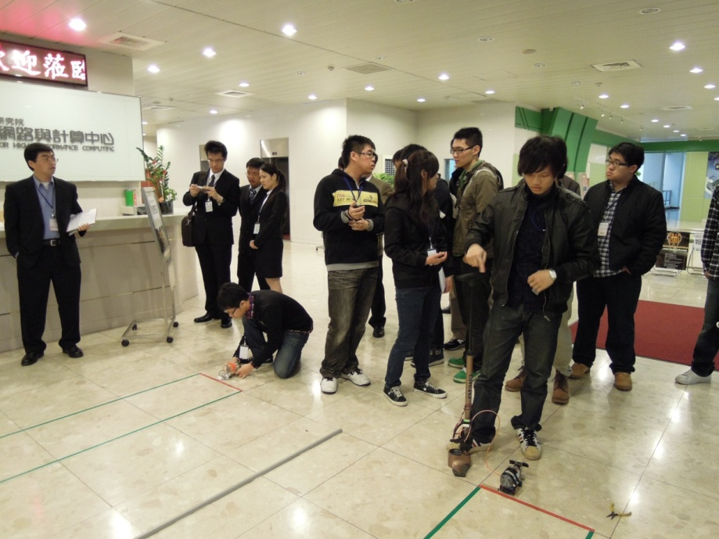
SPDC in Taiwan Section
Photos

Slide 7
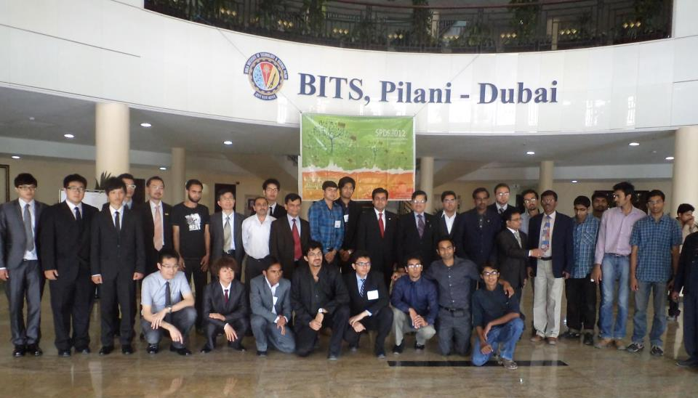
SPDC in Taiwan Section
Champions of SPDC, Taiwan Section attended SPDC, District G in Dubai
  5 students and 2 advisors

Slide 8
Execution Items
Section communications
  Website reconstruction (http://www.asme.org.tw)
    Bilingual interface
    Accessible link to ASME, especially for membership renew
  Membership promotion
Start two or more student sections
  So far only one exists, at National Tsing Hua University (NTHU)
  Target schools: National Taiwan University (NTU) and National Chiao Tung University (NCTU)

Slide 9
Execution Items
SPDC in Taiwan Section
  Increase number and diversity of participants
Section operations
  Update section history
  Raise operation funding
  Hold section meeting twice per year
Notes:
理監事會議 英文？

