Slide 1
7th Asia Pacific District Operating Board Meeting Seoul, South Korea April 21 - 22, 2012 Mokhtar Awang, PhD Section Chair

Slide 2
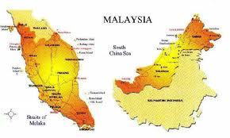
Background
Since April 2010

Slide 3
Chronology
April 2010 – Invitation by Ilic Vojislav to be the ASME correspondent for Malaysia
August 2010 - Attended ASME Singapore section 25th anniversary dinner – Met Vic and Singaporeans members
Late October 2010 – start the petition
Jan 2011 – Attended dinner gathering with Bob Simmons, ASME President in NTU, Singapore
March 2011 – Attended LTC in Dallas
Mid March 2011 – submitted petition forms and request for logo
End March 2011 – received the logo
April 23- 24, 2011: District Operating Board Meeting, KL
July 22, 2011: First Exco meeting
September 9, 2011: 2nd Exco Meeting
March 2012: Vice chair attended the LTC
April 2012: Submitted to ROS

Slide 4
Members
Active member – 195 (April 2012)
93 (April 21, 2011) → 110 % increase

Slide 5
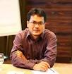
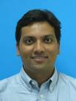
Pro Tem Executive Committee
Chair
Mokhtar Awang
Vice Chair
Srithar Rajoo
Treasurer
Mohd Khairol Anuar Mohd Ariffin
Secretary
Les Gray

Slide 6
Way Forward
Call for Special AGM in December 2012 – brief members the progress that has been made
Collaboration with local professional bodies
Institute Engineers Malaysia (IEM)
The Institute of Marine Engineering, Science & Technology (IMarEST), Malaysian chapter

Slide 7
Student Section
ASME-UTP student section
75 members
Advisors: Dr Mokhtar Awang, Dr Azmi Wahab

Slide 8
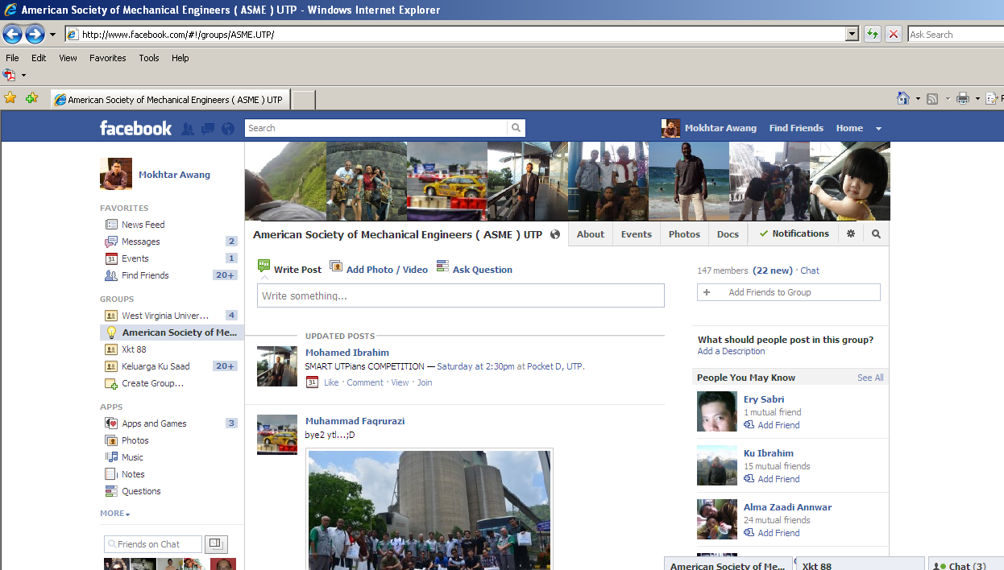
ASME-UTP Facebook

Slide 9
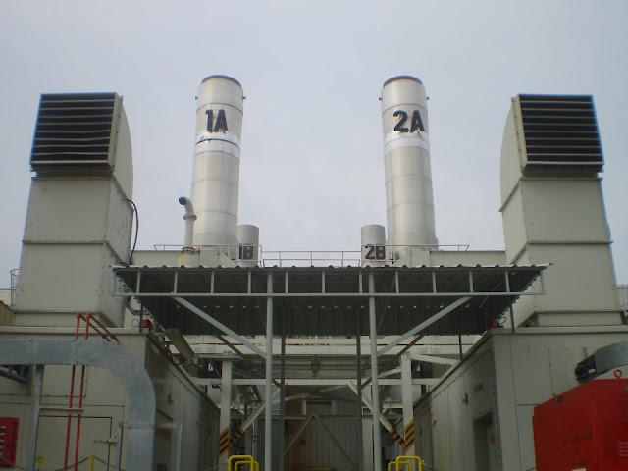
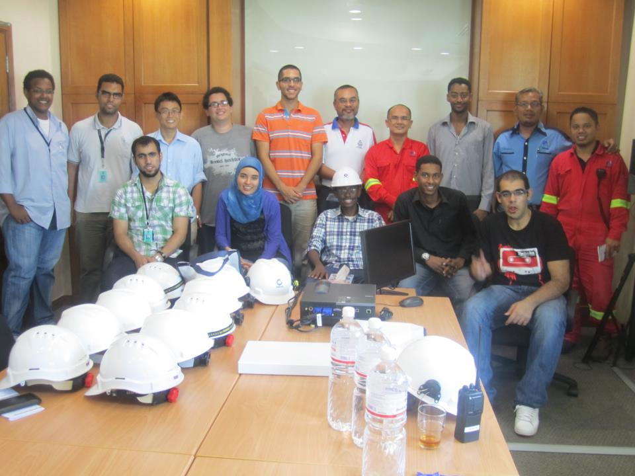
Field Trip – Gas District Cooling, UTP
February, 25 2012

Slide 10
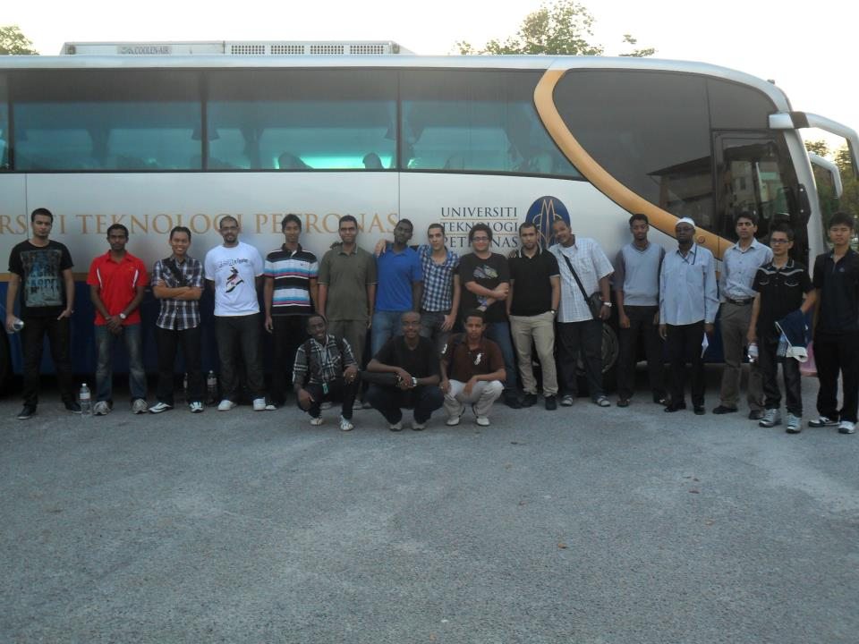
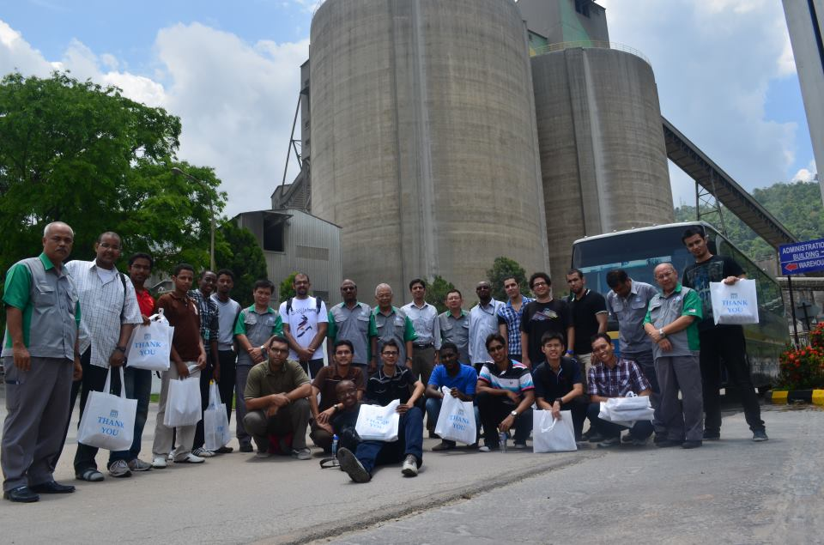
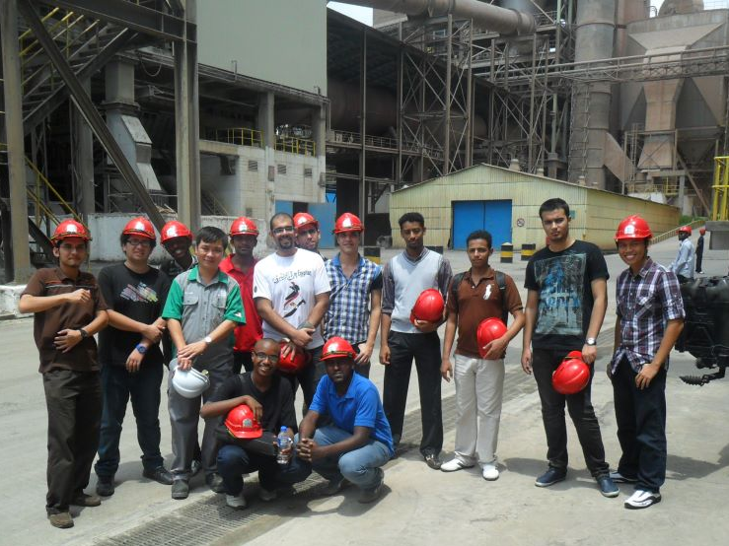
Field Trip - YTL
April, 5 2012
Participated by 18 members

Slide 11
Smart UTPians Competion

